Slide 1
Breaking the Halo Empowering Students in Outdoor Education
Based on the book Breaking the Halo by Katjarina Hurt, 2019.
Notes:
Presentation time should be 1-1.5 hours including time for critical thinking questions.
Key Points
Briefly introduce the presenter(s).
Please explain that this material is provided for educational purposes by the author, Katjarina (caught-cha-ree-nah) Hurt.
Background: the author, Katja (caught-cha) wrote the book “Breaking the Halo” after her best friend and fellow climbing student was killed on what should have been an easy climb in 2018. Following her friend’s death, Katja (caught-cha) began presenting and self-published a short book about the lessons-learned from the incident. Today’s presentation is adapted from the ones she would deliver to her local climbing groups and is provided through her website for any classes wishing to teach Breaking the Halo.

Slide 2
Origins
Edward Thorndike – Halo Effect
Ian McCammon, NOLS
Expert Halo
Image: needpix.com
Notes:
Say something like “This presentation is about confronting complacency, assumptions and communication errors that can occur in the outdoor world. These “thinking traps” are described as halos. In this presentation, we are going to look at six types of halos.
First, why “halos?”
Key Points
Briefly describe/explain what a halo is (i.e. an angel with a halo)
Briefly explain Edward Thorndike’s research
Early 1900s
Documented the “mental shortcuts” our brains use
Thorndike documented the presence of the halo effect in how military officers formed judgments about new soldiers. He watched as the first impression an officer had of a new soldier tended to carry forward into how they rated the soldiers overall.
Positive first impressions gave the soldier a “positive glow” or a halo of overall goodness.
Conclusion: our brains are wired to accept judgements largely based on our first impressions.
Briefly talk about Ian McCammon
Early 2000s
National Outdoor Leadership School (NOLS) instructor
Looked at 30 years’ worth of avalanche incidents and found several common themes.
These themes began to be included in avalanche education. One theme: the expert halo.
Tends to impact novices/beginners.
Refers to the tendency to not speak up for yourself due to your own lack of experience.
Idea of putting a halo of perfection over the “expert” in the group.

Slide 3
Objective
PREVENT THIS…
HOW?
Simplify Terms
Discuss in a Greater Context
Promote Critical Thinking
Action Steps
Notes:
Key Points
The goal of Breaking the Halo is to help prevent more accidents/tragedies.
How we can do this in outdoor education:
Simplifying the discussions and terms around thinking errors and common mistakes.
Talk about halos everywhere, not just in avalanche awareness.
Encourage critical thinking with specific examples and questions.
Provide action steps and the tools for students to make decisions.

Slide 4
The Leader Halo
Image: Katjarina Hurt
Notes:
Key Points
Similar to McCammon’s “expert halo”
Leaders can be formally appointed or can emerge in leader roles without an official title.
In a classroom, instructors/mentors/leaders have authority based on their role.
Seeing someone’s expertise/skill in one area might translate to assumptions about their skills in another area.
This can happen with mentors and peer-groups, not just course instructors.

Slide 5
What are some resources you can use to learn more about the people you are heading outdoors with? Where is the line between looking up to someone for their skills/abilities and seeing them as infallible? How can we respect those with more experience without placing the Leader Halo on them?
Notes:
Critical Thinking Questions—FOR PARTICIPANTS TO ANSWER
Allow time for participants to view the questions on the slide.
Options:
Pair-Share (recommended for the first one to build rapport/comfort for the participants). (Allow participants to turn and talk to one another about one or all of these questions. Monitor discussions by walking around the room. Limit to several minutes.)
Volunteers (ask for volunteers to answer/discuss any of these questions. If no volunteers, use prompts or choose one question to ask the group. Try to avoid providing the answers as the goal is to promote critical thinking).
Journal (encourage participants to write down their thoughts/responses to one or all of these. Limit to several minutes).
“Stand, stretch, and think” (especially if the group seems tired or distracted; invite participants to get the blood flowing to promote better brain activity and to stand and stretch for 30 seconds while they think about these questions. After 30 seconds, have them return to their seats.)

Slide 6
Badge Halos
Image: Public Domain Pictures
Notes:
Key Points
Most familiar in civilian world from the Scouts (1900s) awarding merit badges and patches for achievements.
A “badge” isn’t a problem; the risks are in the implications and assumptions behind badges.
There is also a danger when someone is seeking a checkmark or a new badge and does not share their motives/reasons for choosing certain activities or routes with others involved.
Incentives for pushing boundaries.
Constantly pushing beyond the boundaries of “possible” exposes us to unknown risks.
Once a new record is set, mentality may shift from “it can’t be done” to “if they can do it, so can I.”
Gambler’s Fallacy
We may inaccurately predict our success based on the past successes of others.
Belief that luck has a pattern and the universe will even itself out after successive attempts or after others have been unlucky.
Lists and goals are great but each item on the list must be viewed as its own set of challenges/risks.
The Trophy Case
Seeing the badges others have earned can blind us to their current status/skills.
We may assume we know what was put into achieving the badge (time, effort, dedication, etc.) but not know for sure.

Slide 7
Do you know a leader’s motivations for choosing a trip or route? How can you find out? What motivates you to choose a destination? How can you keep from becoming complacent and falling victim to a Badge Halo?
Notes:
Critical Thinking Questions—FOR PARTICIPANTS TO ANSWER
Allow time for participants to view the questions on the slide.
Options:
Pair-Share (Allow participants to turn and talk to one another about one or all of these questions. Monitor discussions by walking around the room. Limit to several minutes.)
Volunteers (ask for volunteers to answer/discuss any of these questions. If no volunteers, use prompts or choose one question to ask the group. Try to avoid providing the answers as the goal is to promote critical thinking).
Journal (encourage participants to write down their thoughts/responses to one or all of these. Limit to several minutes).
“Stand, stretch, and think” (especially if the group seems tired or distracted; invite participants to get the blood flowing to promote better brain activity and to stand and stretch for 30 seconds while they think about these questions. After 30 seconds, have them return to their seats.)

Slide 8
Cairn Halos
Image: Katjarina Hurt
Notes:
Key Points
Define cairns (piles of stones built as memorials or landmarks; often used to mark routes/trails in the outdoors).
Using cairns or any trails/markings comes with several assumptions:
We assume that someone put them there.
We assume the person who put them there knew where they were at and where they were going.
We assume that the trail we are on takes us where we intend to go.
Illustrate with a story (you may use Retracing Their Steps or Cairns in the Snow from the book, or share one of your own that highlights inaccurate assumptions about navigating/following a trail. The point of the story should be that assumptions can lead to mistakes, even among the most experienced or well-meaning people).

Slide 9
When you go outside, do you have more than one way to navigate? What's your backup plan if one doesn't work? If you are in a wilderness area, how can you know what kind of trail you are on? How can you know where it leads?
Notes:
Critical Thinking Questions—FOR PARTICIPANTS TO ANSWER
Allow time for participants to view the questions on the slide.
Options:
Pair-Share (Allow participants to turn and talk to one another about one or all of these questions. Monitor discussions by walking around the room. Limit to several minutes.)
Volunteers (ask for volunteers to answer/discuss any of these questions. If no volunteers, use prompts or choose one question to ask the group. Try to avoid providing the answers as the goal is to promote critical thinking).
Journal (encourage participants to write down their thoughts/responses to one or all of these. Limit to several minutes).
“Stand, stretch, and think” (especially if the group seems tired or distracted; invite participants to get the blood flowing to promote better brain activity and to stand and stretch for 30 seconds while they think about these questions. After 30 seconds, have them return to their seats.)

Slide 10
Backpack & Helmet Halos
Image: Katjarina Hurt
Notes:
Key Points
Both of these halos relate to gear, but in very specific ways that need to be addressed:
Backpack Halos are when we think we know how to use the gear we have, or make assumptions about someone else’s ability to use the gear they have.
Helmet Halos are when we develop a false sense of security or believe we are safer because we are using a piece of safety equipment/gear.
Share an example of each halo relevant to the audience.
Possible examples based on audience/activity:
Kayakers
Backpack Halo: having a spray skirt that keeps waves out of your boat; do you know how to approach and navigate waves in the first place?
Helmet Halo: having a lifejacket on and believing that you’ll be fine if you come out of your boat; do you know the water temperature and how quickly you may get hypothermic in the water even with a lifejacket holding you up?
Skiers/Snowboarders
Backpack Halo: carrying an avalanche beacon, probe, and shovel in case of an avalanche; do the others in your party have these tools, too? Do they know how to use them to find you? Have you practiced locating and rescuing someone?
Helmet Halo: an airbag (for avalanche survival); do you know how to operate it, what actions you need to take once it is deployed, if it is for solo use or if you need a partner to rescue you?
Hikers/Climbers
Backpack Halo: any of the ten essentials—have you practiced using them and do you know how to use them properly or in an emergency?
Helmet Halo: not understanding UIAA helmet ratings and that they protect you from falling objects like rocks but cannot save your neck/spine in a fall.

Slide 11
When have you made a judgment about someone’s skills or abilities based on the gear they had? Do you believe this was an accurate assessment? Why? Do you know how to use your gear? Have you practiced using all of it? Are you aware of the ratings, purpose, and limitations that come with your safety equipment?
Notes:
Critical Thinking Questions—FOR PARTICIPANTS TO ANSWER
Allow time for participants to view the questions on the slide.
Options:
Pair-Share (Allow participants to turn and talk to one another about one or all of these questions. Monitor discussions by walking around the room. Limit to several minutes.)
Volunteers (ask for volunteers to answer/discuss any of these questions. If no volunteers, use prompts or choose one question to ask the group. Try to avoid providing the answers as the goal is to promote critical thinking).
Journal (encourage participants to write down their thoughts/responses to one or all of these. Limit to several minutes).
“Stand, stretch, and think” (especially if the group seems tired or distracted; invite participants to get the blood flowing to promote better brain activity and to stand and stretch for 30 seconds while they think about these questions. After 30 seconds, have them return to their seats.)

Slide 12
The Halo in the Mirror
Image: Stock – foter.com
Notes:
Key Points
Metaphorical because you don’t actually see it on yourself.
Most difficult to break because it is our ego/attitude.
May not be as apparent to us and requires an openness to introspection and self-awareness that can be difficult for many people.
Can occur when we are over-confident, having learned and mastered something and then move on to more challenging things and never go back to practice the basics.
A way to combat this is to use checklists and find ways to stay fresh and not fall into muscle-memory.
When your ego is getting in the way, sometimes you can tell by noticing the words you use.
Pay attention to times you feel a need to correct or contradict someone. Think about why you feel the need to do this and what language/words you use.
Educating/helping someone can be helpful; telling them they are wrong, stupid, or your way is better than theirs should be a huge red flag to check for a mirror halo.
Storytelling can be a great way to share knowledge/teach, but watch out for over-confidence or ego-building motives in storytelling.
Stories should be told to build rapport or share a lesson learned, not to stroke your own ego or put someone else down.
Sharing experiences in a classroom should never be done as an attempt to one-up someone else or push back your own discomfort or embarrassment. Stop and think about what is really going on.

Slide 13
What is the difference between confidence and over-confidence? How can you check yourself for a Mirror Halo? Who do you trust to tell you if they see one? How will you respond to feedback?
Notes:
Critical Thinking Questions—FOR PARTICIPANTS TO ANSWER
Allow time for participants to view the questions on the slide.
Options:
Options:
Pair-Share (Allow participants to turn and talk to one another about one or all of these questions. Monitor discussions by walking around the room. Limit to several minutes.)
Volunteers (ask for volunteers to answer/discuss any of these questions. If no volunteers, use prompts or choose one question to ask the group. Try to avoid providing the answers as the goal is to promote critical thinking).
Journal (recommended as this is a very personal topic) (encourage participants to write down their thoughts/responses to one or all of these. Limit to several minutes).
“Stand, stretch, and think” (especially if the group seems tired or distracted; invite participants to get the blood flowing to promote better brain activity and to stand and stretch for 30 seconds while they think about these questions. After 30 seconds, have them return to their seats.)

Slide 14
Breaking the Halo
Breaking Complacency
Empowering Communication
Breaking Assumptions
Standing Your Ground
Image: Wikimedia user Bolo77 – Creative Commons
Notes:
Say something like: “As you may have noticed the themes among the six halos include complacency, assumptions, and communication breakdowns. Being able to identify these challenges and address them can be difficult, whether among peers or in a new environment. This is why there are critical thinking questions with each—you have to start somewhere. Hopefully by promoting critical thinking, we can identify and respond better to halos when we see them.”
Key Points
Acknowledge that speaking up/responding can be difficult, especially as a student or beginner.
Provide at least three suggestions/actions for each topic, using the ones listed or others you have come up with:
Breaking Complacency
Find a way to break routine or add words to a routine to engage more of your brain when going through it.
Use checklists before packing or starting out on an adventure to check yourself.
Make a ritual with a piece of clothing or jewelry that you only wear for certain activities and use it to develop a mindset of safety and awareness.
Review the halos and questions and discuss them with your friends/colleagues.
Breaking Assumptions
Stop and think about the things you say or automatic decisions you make.
Be willing to challenge yourself and correct your own assumptions.
Solicit feedback from others around you, even if it seems like an obvious decision you are making.
Practice humility—apologize if you are wrong and neve be ashamed to admit that you need a refresher or a skills review.
Empowering Communication
Always work on your communication skills: know how to actively listen, and work on effectively stating your feelings and thoughts.
Try to eliminate judgment words and statements from your communication style and be on the alert for their use with others.
Ask for feedback and think about how it is communicated to you. Practice what is helpful for you in how you give feedback to others.
Acknowledge feelings/emotions that can get in the way of clear communication. The thinking brain doesn’t operate well when it is overridden by the feeling brain.
Standing Your Ground
Say something like: “If you manage to voice your concerns and you are not comfortable with the response, you still have options.”
Ask what options are available.
Call for a timeout, especially if emotions are high or there seems to be pressure to make a quick decision or a sudden action.
Stand your ground—literally. Except in extreme cases of imminent danger, no one has the right to touch you without your consent.
Support the person speaking up; be careful that group-think or peer pressure doesn’t stifle their ability to voice a real concern.
Remember that there are consequences for actions, good and bad. Think through these options and potential situations before they happen. Being prepared and having a plan are important parts of staying safe in any situations.

Slide 15
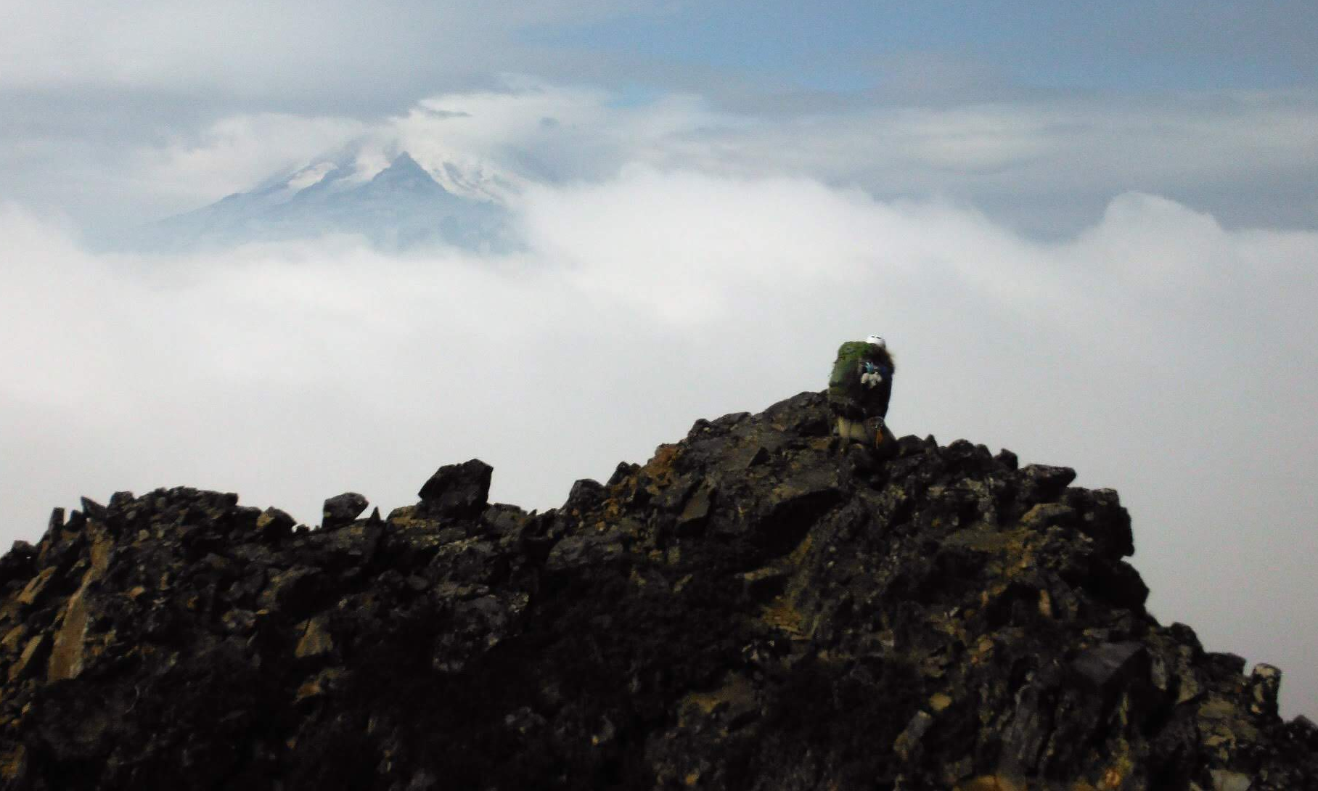
It’s up to each of you to break every halo you see.
Image: Mike McIntosh
Notes:
Conclude the presentation.
Say something like:
“Always remember that you are the one more responsible for your own safety. We want to believe that our peers, instructors, and leaders will do the right thing and help us stay as safe as possible, but at the end of the day, it comes down to you. You may feel silly or stupid for speaking up and finding out that you were wrong. It may cause embarrassment or awkwardness within the group and you may not be invited on future outings. But you know what? Those hurt feelings are not what get people killed. If discomfort and embarrassment are keeping you alive, then choose life and have no shame. Sometimes the right options are not the most socially pleasant or acceptable, and that is alright.”
“It’s up to you to break every halo you see.”
Photo Note:
The photo if of the author kneeling at the site where her best friend fell to his death, two weeks after the incident. It was taken by one of the research-team members after the investigation was concluded and the author asked for a moment alone to say goodbye.

